Slide 1
CA LAB 7

Slide 2
WAVES
Waves is a common term for a number of different ways in which energy is transferred.
Data can also be transferred using waves.
Electromagnetic waves

Slide 3
Simple Approach To Transmit Data using Light

Slide 4


Slide 5
Infrared (IR)
Infrared radiation is a form of light similar to the light we see all around us.
The only difference between IR light and visible light is the frequency and wavelength.
Infrared radiation lies outside the range of visible light, so humans can’t see it
It is visible from camera eye

Slide 6
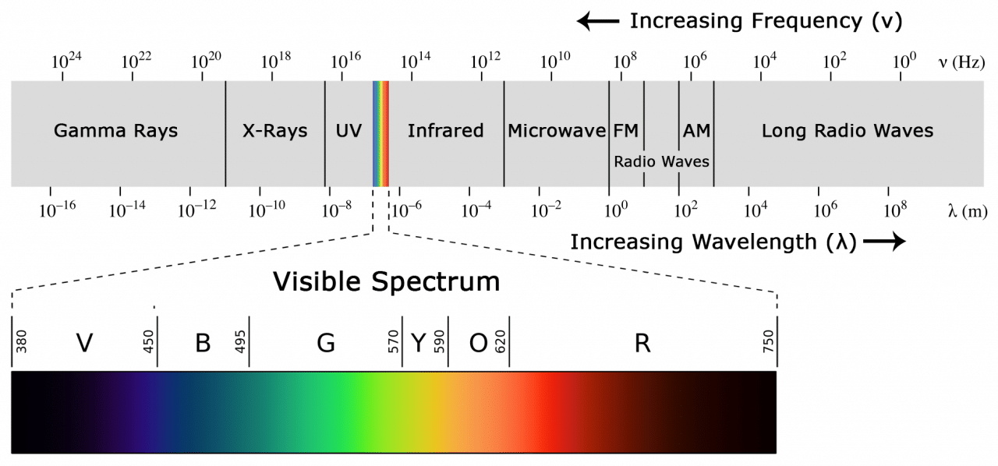

Slide 7
Working of IR
Require transmitter and receiver.
Transmitter send an encoded binary signal in form of IR.
Modulation technique is used to prevent noise.
The IR receiver then demodulates the IR light signal and converts it back to binary before passing on the information to a microcontroller.

Slide 8
Working of IR
The modulated IR signal is a series of IR light pulses switched on and off at a high frequency known as the carrier frequency.
The carrier frequency used by most transmitters is 38 kHz.
The receiver diode detects all frequencies of IR light, but it has a band-pass filter and only lets through IR at 38 kHz.

Slide 9
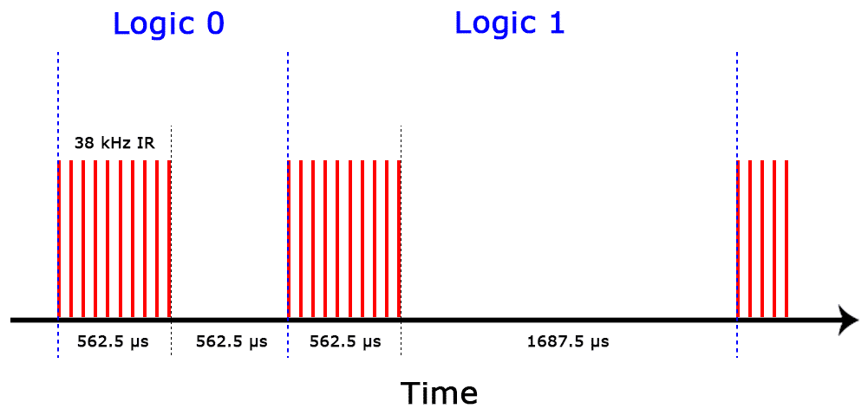

Slide 10
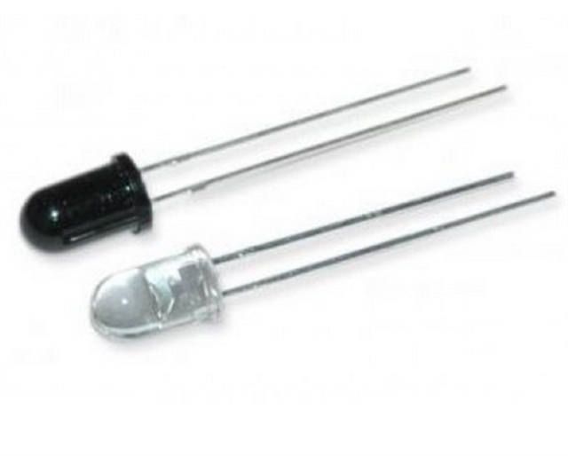

Slide 11
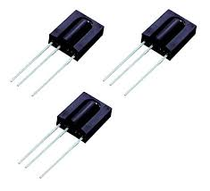
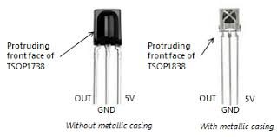

Slide 12
IR Sensor Example
TV/video remote controls.
Motion sensors
Infrared thermometers.

Slide 13
IR Library
#include <IRremote.h>
IRrecv irrecv(receivePin):
Create the receiver object, using a name of your choice.
irrecv.enableIRIn():
Begin the receiving process. This will enable the timer interrupt which consumes a small amount of CPU every 50 µs.

Slide 14
irrecv.decode(&results):
Attempt to receive a IR code. Returns true if a code was received, or false if nothing received yet. When a code is received, information is stored into "results".
results.decode_type: Will be one of the following: NEC, SONY, RC5, RC6, or UNKNOWN.
results.value: The actual IR code (0 if type is UNKNOWN)
results.bits: The number of bits used by this code
results.rawbuf: An array of IR pulse times
results.rawlen: The number of items stored in the array

Slide 15
irrecv.resume():
After receiving, this must be called to reset the receiver and prepare it to receive another code.
irrecv.blink13(true):
Enable blinking the LED when during reception. Because you can't see infrared light, blinking the LED can be useful while troubleshooting, or just to give visual feedback.

Slide 16
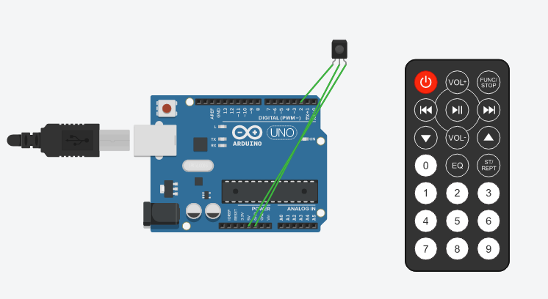

Slide 17
CODE
#include <IRremote.h>
const int RECV_PIN = 2;
IRrecv irrecv(RECV_PIN);
decode_results results;
void setup(){
Serial.begin(9600);
irrecv.enableIRIn();
irrecv.blink13(true);
}
void loop(){
if (irrecv.decode(&results)){
Serial.println(results.value, HEX);
irrecv.resume();
}
}

Slide 18
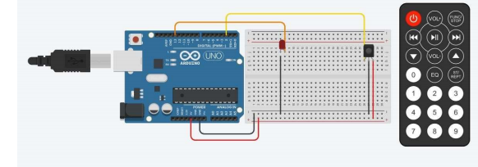

Slide 19
Code
Refer to page no 49 of your lab manual

